Slide 1




EXPLORING CRIME IN RELATIONSHIP TO INCOME AND POPULATION IN LONDON
ADVANCED DATA MANAGEMENT PROJECT
Divya Vasantha(32025714)
Sruthi Sreenivasan(32037053)
Modupe Salu(32037373)
Oluwatosin Tanimola(32003577)
Vishal Pal(31062565)

Slide 2
BUSINESS CASE
With a sizable population, London is one of the biggest and most diversified cities in the world. Numerous neighbourhoods in London are impacted by crime which occurs in diverse forms and at varying rates Scott (2015). According to Andresen, Malleson, and Kinney (2015), incorporating factors such as income and population density is important in understanding crime patterns in specific locations. This means the first step in creating efficient plans for reducing and addressing crime in the city is to understand the connection between income, population, and crime.
The purpose of this analysis to explore the relationship between income, population, and crime in London. By analyzing data from various sources, including crime statistics, income data, and population data, we aim to identify patterns and trends in crime rates in different areas of the city, law enforcement agencies can gain a more nuanced understanding of crime patterns and develop more targeted and effective crime prevention strategies which will improve public safety. It also allows for a more holistic understanding of crime patterns and provides valuable insights that can inform policy decisions.
Overall, this study has the potential to contribute to a better understanding of the factors that influence crime in London and to inform the development of evidence-based policies and interventions for reducing crime rates in the city.

Slide 3
Business Question With Justification
Question | Justification
1.What are the trends and patterns in crime, population, and income across different regions of London from 2016 to 2019? 2.What are the top three types of crime recorded in the 10 most populated boroughs of London from 2016 to 2019? 3.What is the highest crime count and most occurred type of crime recorded in different boroughs of London quarterly from 2016 to 2019? | To analyse the trends and patterns in crime, population, and income across different regions of London from 2016 to 2019 can provide valuable insights for policymakers, law enforcement agencies, and businesses, and can help to inform decisions related to resource allocation, crime prevention, economic development, and consumer behaviour(Ratcliffe & McCullagh, 1998) To prioritize resource allocation: By identifying the top three types of crime recorded in the 10 most populous locations of London, law enforcement agencies and policymakers can prioritize resource allocation for crime prevention and investigation efforts. For example, if theft and burglary are the top two types of crime recorded in a particular area, law enforcement agencies may consider increasing patrols or installing more security cameras in that area to reduce crime. (Sathyadevan et al., 2014) To monitor progress: By tracking crime rates and types of crime across different regions of London over time, law enforcement agencies and policymakers can monitor progress in reducing crime rates and evaluate the effectiveness of policy interventions. For example, if a certain region experiences a significant decrease in crime rates during a particular quarter, law enforcement agencies and policymakers can evaluate their strategies, and analyse if its effective. in order to expand it to other regions. (Kattankulathur, 2018)

Slide 4
Business Question With Justification(contd)
Question | Justification
4.How many reported crime cases by type were completed monthly by investigation in all regions of London from 2016 to 2019? 5.What are the top 3 subregions with highest crime rate in Boroughs of London in 2019 are most in need of increased security measures? | Assessing crime trends: By analysing the number of reported crime type cases completed by investigation in all regions of London monthly from 2016 to 2019, we will be able to assess trends in crime over time. This can help identify if certain types of crimes are on the rise or decline, which regions are most affected by crime, and whether there are any seasonal or cyclical patterns to crime. Identifying high-risk areas: Analysing crime rates in different regions and subregions of London can help identify areas that are at higher risk of criminal activity. This information can be used by law enforcement agencies and other organizations to focus their efforts and resources on these areas and implement targeted security measures that address the specific needs of each location.

Slide 5
Dataset
TABLE SHOWING DATA SOURCING
Data Parameter | Source | Granularity | Available Variables | Year Of Data
London crime data | https://data.police.uk/data | Month | Location, LSOA code, Crime type, outcome category | 2016-2019
Earnings data in London | https://www.nomisweb.co.uk/ | Year | LSOA code, LSOA name, Employment variables | 2002 - 2021
Employment Rate and Unemployment Rate by Ethnic Group & Nationality, Borough | https://www.ons.gov.uk/employmentandlabourmarket/peopleinwork/earningsandworkinghours/datasets/smallareaincomeestimatesformiddlelayersuperoutputareasenglandandwales | Year | LSOA code, LSOA name, Employment variables - 2019 - 2021 | 2016-2019
Income estimates for small areas, England and Wales | https://www.ons.gov.uk/employmentandlabourmarket/peopleinwork/earningsandworkinghours/datasets/smallareaincomeestimatesformiddlelayersuperoutputareasenglandandwales | Year | Average income, net income, Net income before house rent, Net income after house rent | 2016-2019
land area population density | https://data.london.gov.uk/dataset/land-area-and-population-density-ward-and-borough |  | Area codes, Area name, inner/outer London, Population estimate/projection, Inland area, total area, population per hectare, square kilometre, census population - 2011, | 2016-2022
Table 1:1 This tables shows all data we looked at, however we only used london Crime data, Earning data in london and Land area population density for our analysis, this three are highlighted
Notes:
Table 1:1 This tables shows all data we looked at, however we only used london Crime data, Earning data in london and Land area population density for our analysis, this three are highlighted

Slide 6
OVERVIEW OF DATASET
Chosen Dataset
We selected London Borough crime data , Earning data and land area population density dataset for three years 2016-2019
Reason for choosing Dataset
We chose this dataset because the data are relevant to our analysis, it has over 4 million observations, it is an open data and available in excel format which is great for our analysis.These information can help in analysing and recommending further action to be taken.
How the dataset would be joined
We chose a dataset with common variable to allow linkage. The common variable used as a control is the MSOA (Middle Layer Super Output Area). The MSOA provide details about the regions while the LSOA gives insight about sub-regions. Its easy to deduce and aggregate the MSOA from the LSOA since the subregions makes up the regions.

Slide 7
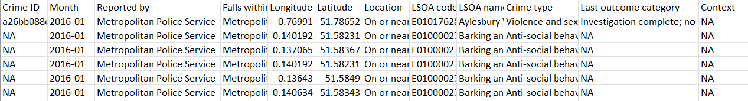
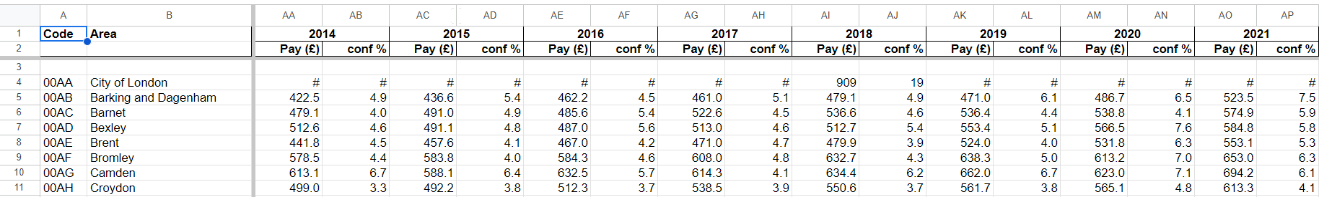
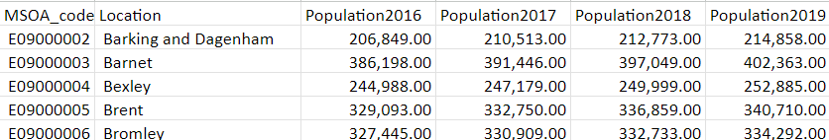
Dataset Sample
Dataset Samples
Fig 1.1Sample Crime Data
Fig 1.2 Population Data
Fig 1.3 Sample Earning Data
Notes:
Fig1.1 Show the sample crime data
Fig1.2 Show the sample population data
Fig 1.3 Shows the earning data

Slide 8
Dataset key features
The following are the main characteristics of the datasets that accurately reflect the crime, population, and income statistics as confirmed and released by the UK local authorities:
ID: This column shows the identification of each instances of crime, population and income.
Date: This displays the time frame (2016-2019) during which the data was gathered.
LSOA Code: Provides a summary of demographic and related data for each Lower Super Output Area in Greater London
MSOA Code: Middle Layer Super Output Areas ( MSOA) are a geographic hierarchy designed to improve the reporting of small area statistics in London.
Crime Type: It includes a range of offences from minor offences such as harassment and theft to serious offences such as violence, The crime type is grouped below
Violence and Sexual Offence
Drugs
Anti-Social Behavior (anti-social behaviour & Possession of weapon)
Public Order
Theft (Bicycle theft, other theft, robbery, shoplifting, theft from the person, Bulgary)
Crime (Vehicle Crime, other crime, criminal damage and arson)
This makes it a total of 6 crime type
Outcome: This describes the current status of the investigation 8

Slide 9




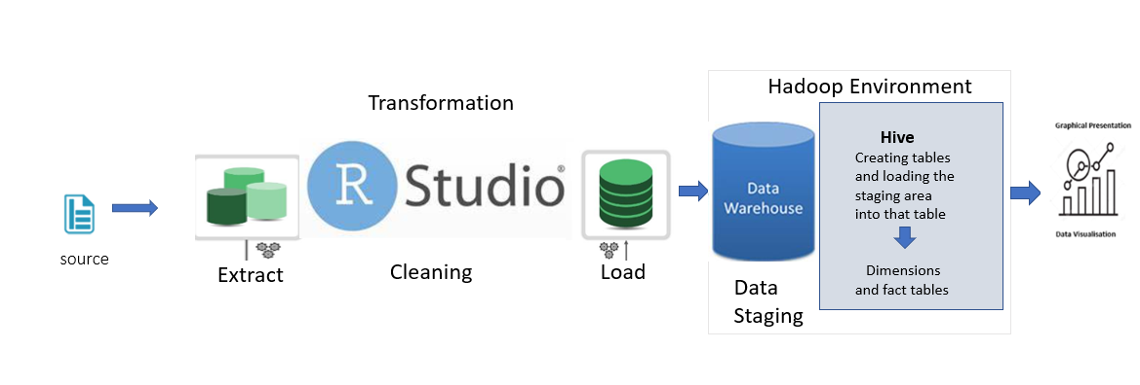
Justification of Tools
A user-friendly interface
An open-source tool
Data cleaning and validation check
Data Manipulation: filtering, sorting, merging, and reshaping data.
Join the large datasets
Quickly Create Interactive visualizations.
Ease of Implementation:
Develop an interactive database quickly.
Provide high performance and high fault tolerance.
To load and store tables
To help collect, store, process, analyze, and manage big data.
Used to efficiently store and process large datasets.
Ability to query large datasets.
Support for multiple data formats.
Fast execution.
Fig 1.4 : shows ETL process

Slide 10
Software Recommendation: Tableau, R and Hadoop
Tableau, R and Hadoop are three softwares tools that can greatly benefits businesses and organisations by providing great analysis capabilities, These tools can help company to extract insights from large and complex datasets, which will enable the organisation to make better informed decisions.
Tableau: is a data visualization tool that allows users to create interactive dashboards, reports and charts from various data sources, it has a great user-interface which makes it easy for user to analyse and present their data in a visually appealing way. Tableau has a robust data connection capability, this enables users to connect data from various data sources, such as spreadsheets, databases and cloud service.
Hadoop: is a distributed computing platform which is designed to store and process large datasets, and it can handle vast amounts of data in a scalable and cost effective manner
R Studio: has a rich set of libraries and functions for manipulating and transforming data. it enables the data to be cleaned and transformed into a format that is suitable for analysis
Overall, Tableau, R and Hadoop are all valuable tools to analyse large and complex datasets, these tools can be used together to provide comprehensive set of data analysis. We highly recommend these tools for the company, this will be useful to extract insights from data and make better informed decisions.

Slide 11
Project methodology
Project development using a bottom-up approach
ETL procedure and star schema construction for data mart
Project Methodology
validation and testing for data structure
controlling every aspect of the management process through wise decision-making and creative problem-solving
created a sample process, tasks monitoring, delivery scheduling, and delay management using Google Docs.
It is intended to improve workflow efficiency, reduce job delays, and aid in task visualisation.
Dig 1.1 : Project Methodology

Slide 12
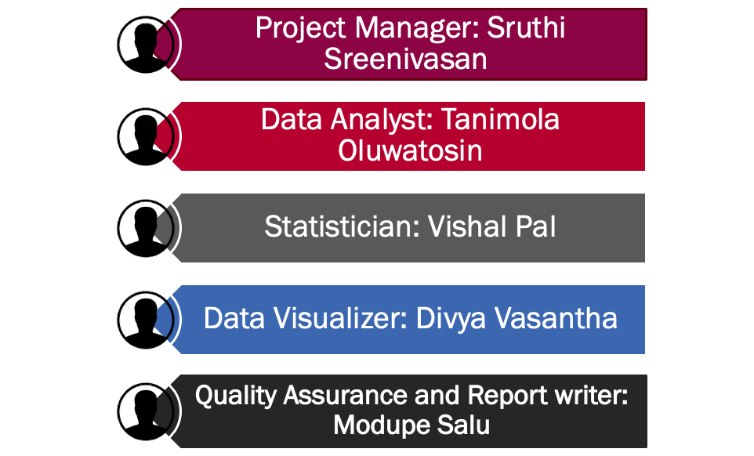
Roles and responsibilities
Leads the Team and keep track of the project,Implement ETL Process, Creates management strategies for high-quality data collecting to guarantee data sufficiency, accuracy, and legitimacy.
Extract ,Transform and Load Data using R Studio, Created Dim and Fact table
,Interpreting data, analysing results , Performing analysis to assess the quality and meaning of data
Collected Data from various sources, utilized various visualization, Made decisions based on data and evaluating information
Automates process (R to Hive) ,Uses Tableau for Data Visualization, Evaluated modeling outputs
Data Cleaning and perform data validation and transformation, Solve technical error Effective Presentation 12

Slide 13
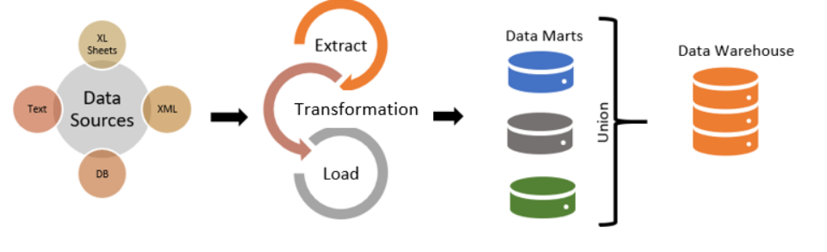
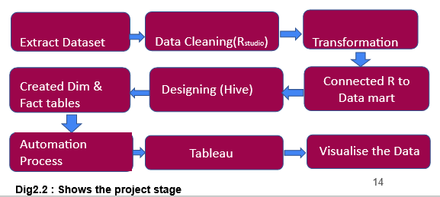
Project Approach
Dig 2.1 Kimball’s bottom-up approach,Ref from:www.bing.com

Slide 14
Justification for using Bottom-Up Approach
The approach is great for structuring data from a certain focus area. Kimball dimensional modelling may be created quickly because no normalization is necessary. Due to its denormalized structure, star schema has the benefit of being easily understood by most data operators. Since data is divided into fact tables and dimensions, it enables quick data retrieval from the data warehouse. The optimization of queries is simple and manageable and this method requires less time.
Conformed dimensional structure for data quality framework.

Slide 15
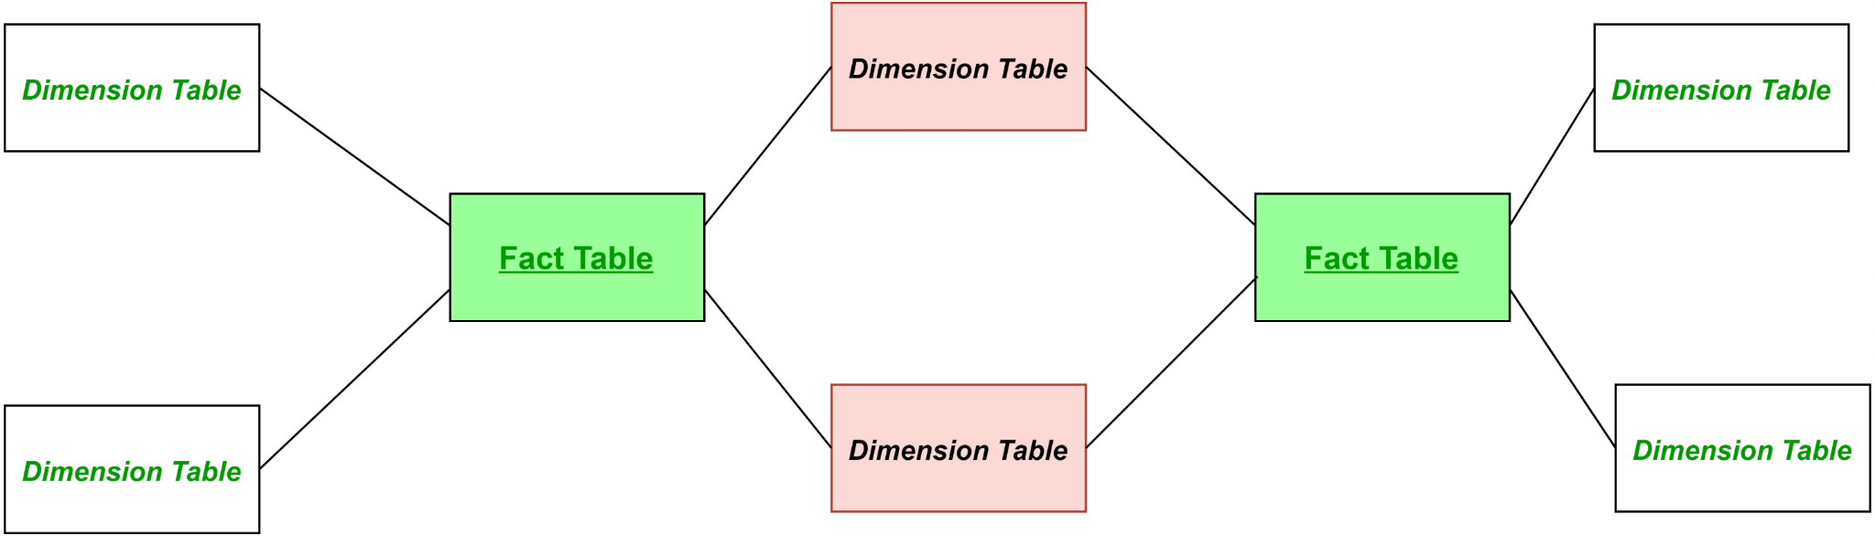
Constellation and its justification
A multidimensional model representation schema which is formed by the interconnectivity of multiple independent data marts. It can be seen as a combination of many star systems. It is a standardised version of the star and snowflake diagram. To obtain data from the database, extremely complicated queries are used.
JUSTIFICATION
We used constellation method to provide flexibility and scalability architecture that is capable of accommodating changes and growth over time.
It is beneficial because each data mart within the constellation can be independently designed and implemented on its own and this will allow easy management of complex database structure.
We have also chosen the use of constellation because of its easy administrative and maintenance for database management. Since each data mart can be managed separately, it allows changes and update without causing a major disruption to the entire system.
Fig 2.3 : Fact constellation, Ref from:bing.com

Slide 16
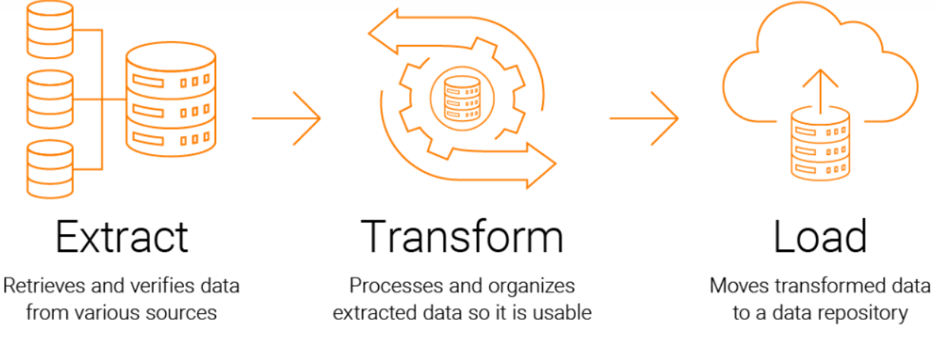
Justification for using ETL Method
"Extract, Transform, Load" (ETL) is the process of taking data from a source, transforming it into a suitable format useful for analysis, and then loading it into a final target system (often a data warehouse). ETL has existed from the beginning of the data warehouse itself.
Why we chose ETL Method
We chose ETL because we are dealing with historical dataset and ETL supports large volumes of data. ETL involves transforming data before loading it into a data warehouse, all our dataset were available and required transformation before loading, also ETL process is scalable and suitable for batch processing, which is a perfect fit for our dataset, unlike ELT that perform real-time or near-real-time processing.
fig2.4 ETL Flow chart. Ref from:stitchdata.com

Slide 17
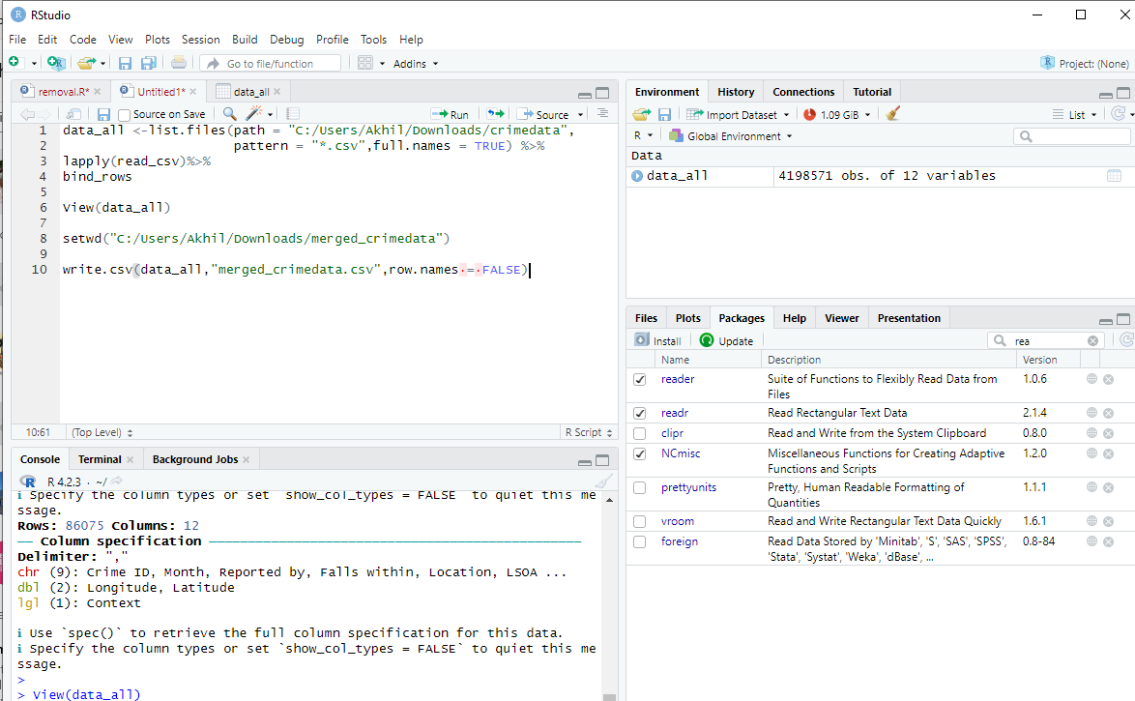
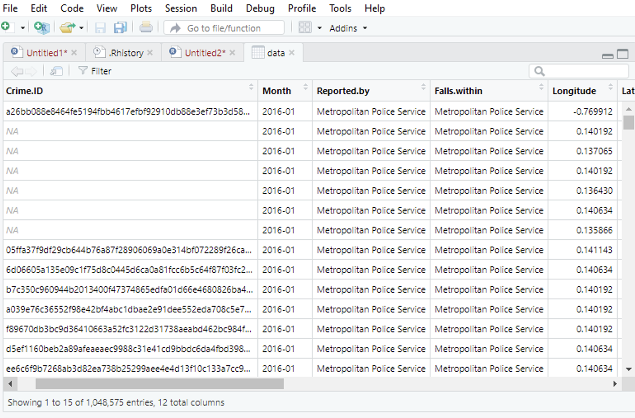
Transformation(ETL Process)
Four year crime data(2016-2019) has been merged in to a csv file.Before cleaning there was 4198571 observations with 12 variables.
Irrelevant columns such as (Longitutude, fallswithin, reported by) were removed since they are not meant to use in analysis.
Renaming columns
Aggregation of data(Outcomes and crime type )
Fig: 2.6: Total observation in raw data
fig:2.5,Raw Crime data before cleaning

Slide 18
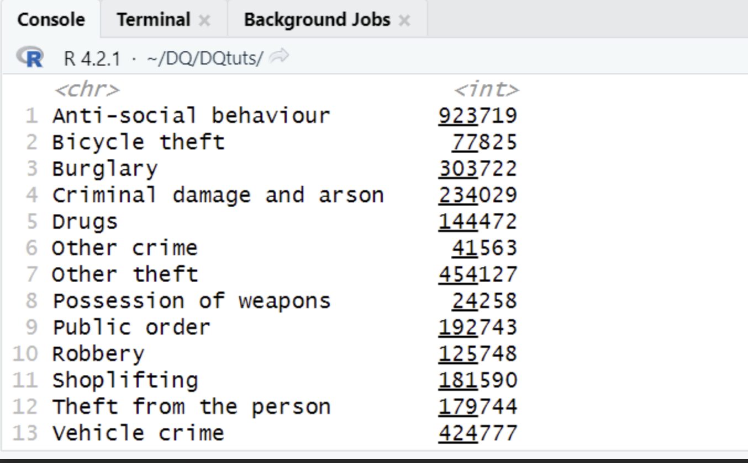
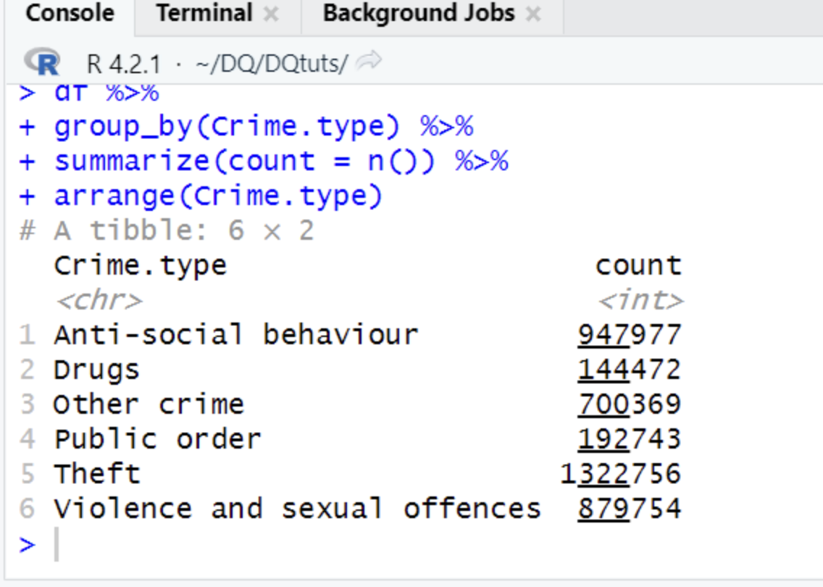
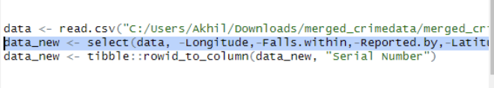
Cleaning Dataset
Crime typewere aggrigated and bough together with distinct ones.
Outcome category in crime data sorted in to clusterd format.
fig3.1 : Shows count of data crime type after categorisation
fig3.2: Code for removal of unwanted columns and insertion of Serial Number

Slide 19
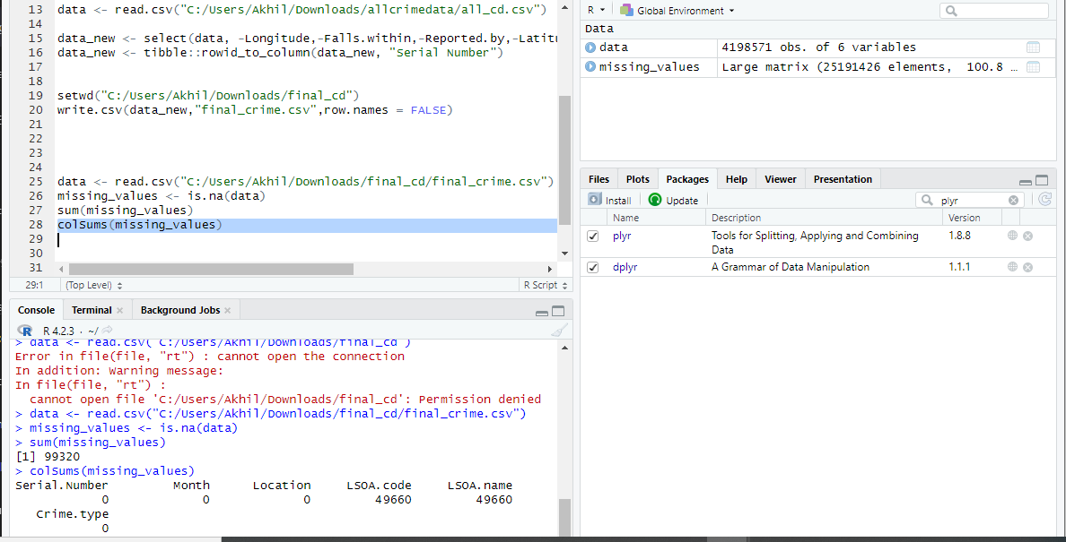
Data Quality and Validation
Evidence of relevant data quality checks carried out and their resolutions are:
It is important to perform data quality check on dataset in order to ensure that the data is accurate, complete, consistent and reliable.
The below activities were performed to check the quality and validate the data.
Checked for missing value -99320 missing values representing about 3% were found an removed
Outliers -Nil outliers
checked duplicate values-No duplicates
Consistency- checked the data is consistent and no contradictions or conflicts in the dataset
Validity- checks the data is accurate and represent the concepts its intended for.
Irrelevant Data: We found records of data that are not relevant with the scope of analysis (London) as record shows data from sheffield, Birmingham, Manchester etc
fig.3.3: checking for missing value in columns

Slide 20
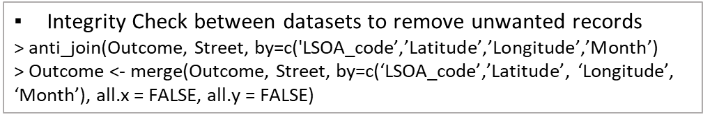
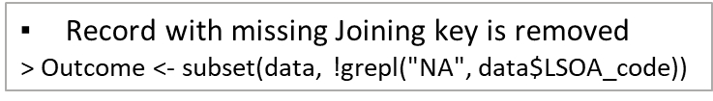
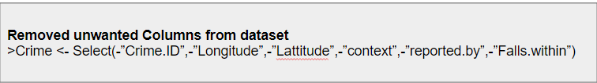
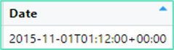
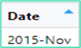
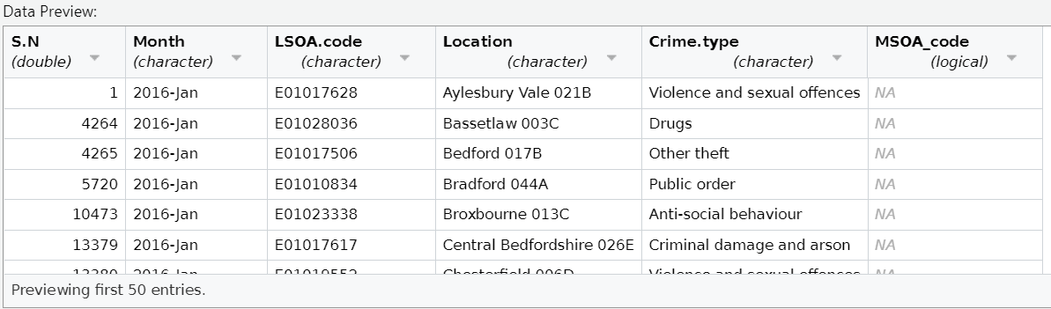
Data Quality Check
fig 3.4
IRRELEVANT DATA

Slide 21
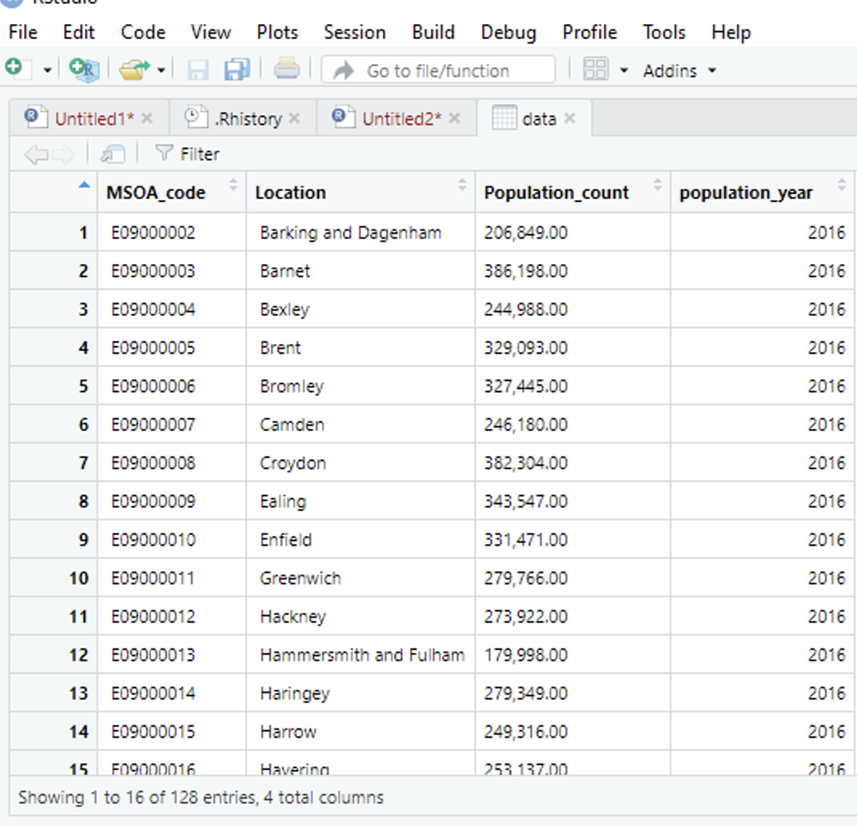
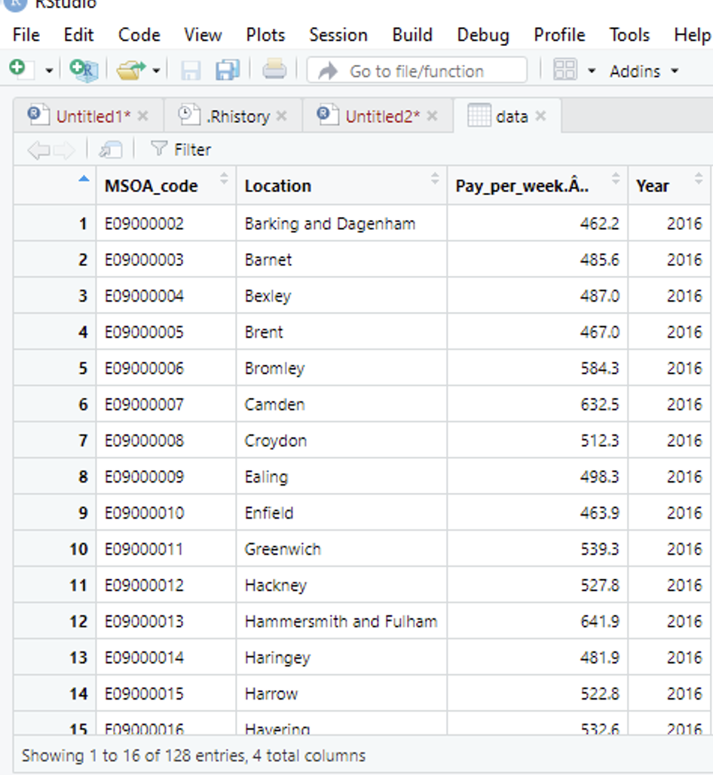
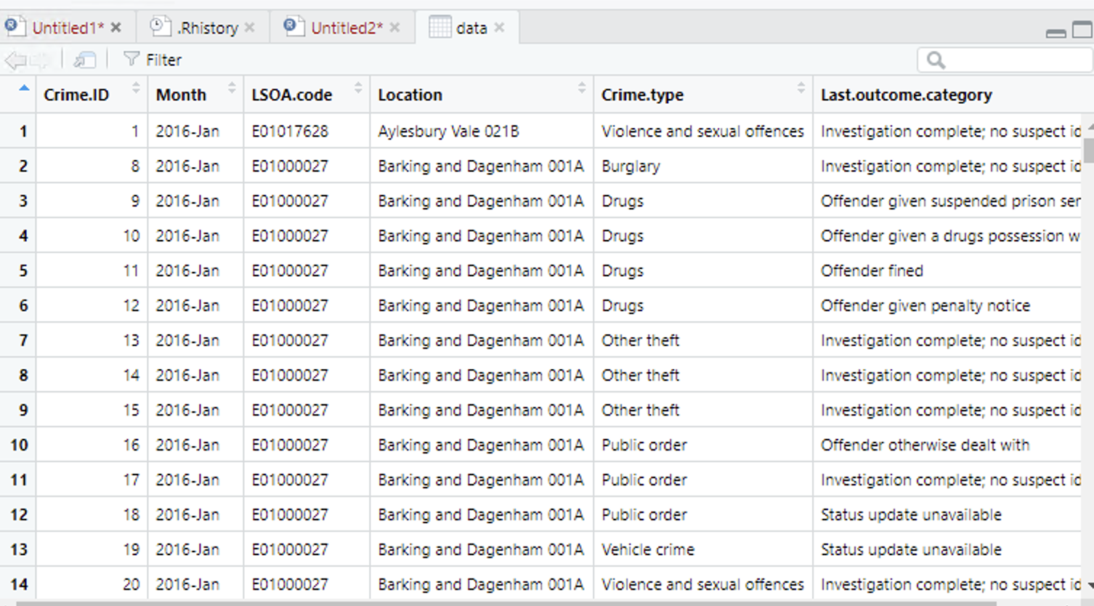
Cleaned Datasets
fig 4.2: shows cleaned Earnings dataset
fig4.1: shows cleaned population dataset
fig 4.3: shows cleaned crime dataset

Slide 22
STAR METHODOLOGY
STAR METHODOLOGY
Dimension tables with attributes
1.dimCrime – CrimeID, Crimetype,Outcome
2.dimIncome – IncomeID,Income.
3.dimLocation-LocationID,Location,Sublocation
4.dimPopulation-PopulationID,Population
5.dimTime-TimeID,Year,Month
Lowest level of granularity (for each dimension)
1.dimLocation-Region,Sub-Region
2.dimTime- year, Month,Quarter
Metrics of the problem
1.Crime Count
2.Total number of population
3.Sum of income
Fact Tables definition (keys and metrics)
1.Crime_ID
2.Income_ID
3.LocationID
4.TimeID
5Crime Count
6PopulationCount
7.IncomeSum

Slide 23
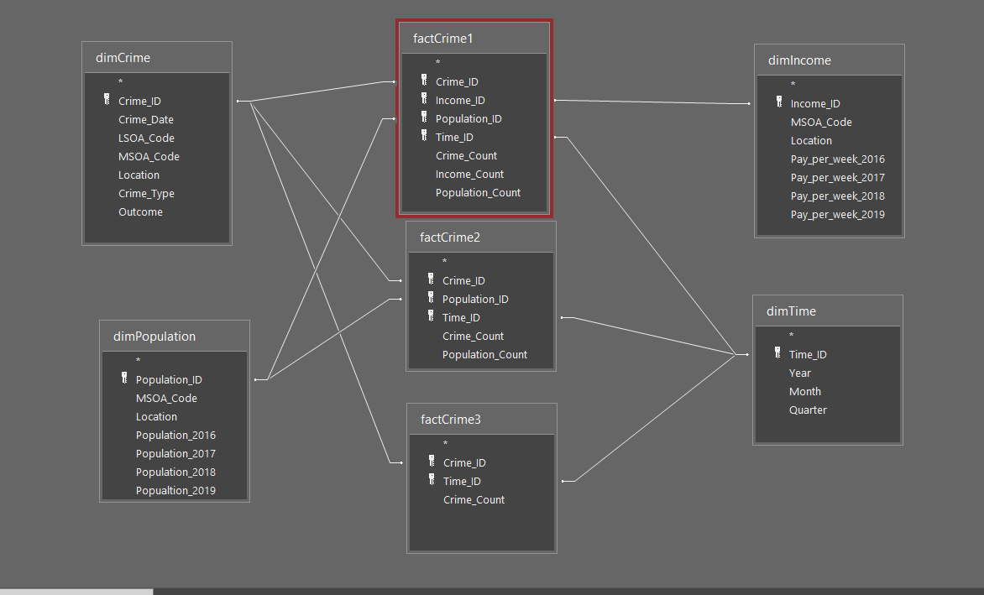
Fact Constellation Schema
Dig3.1 constellation star schema

Slide 24
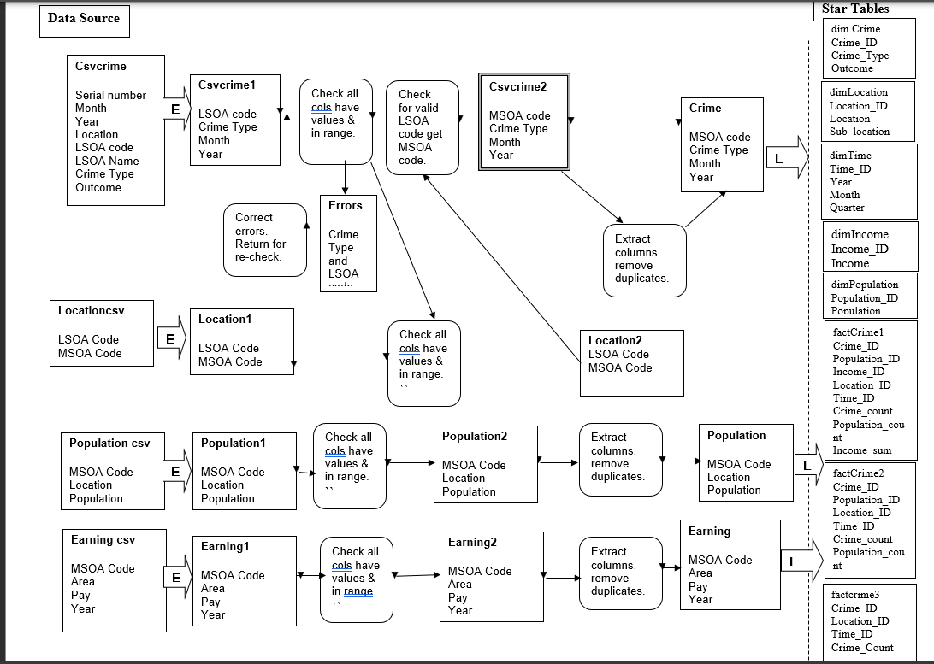
DATA VALIDITYDATA STAGING
Fig 3.2 representation ofData staging

Slide 25
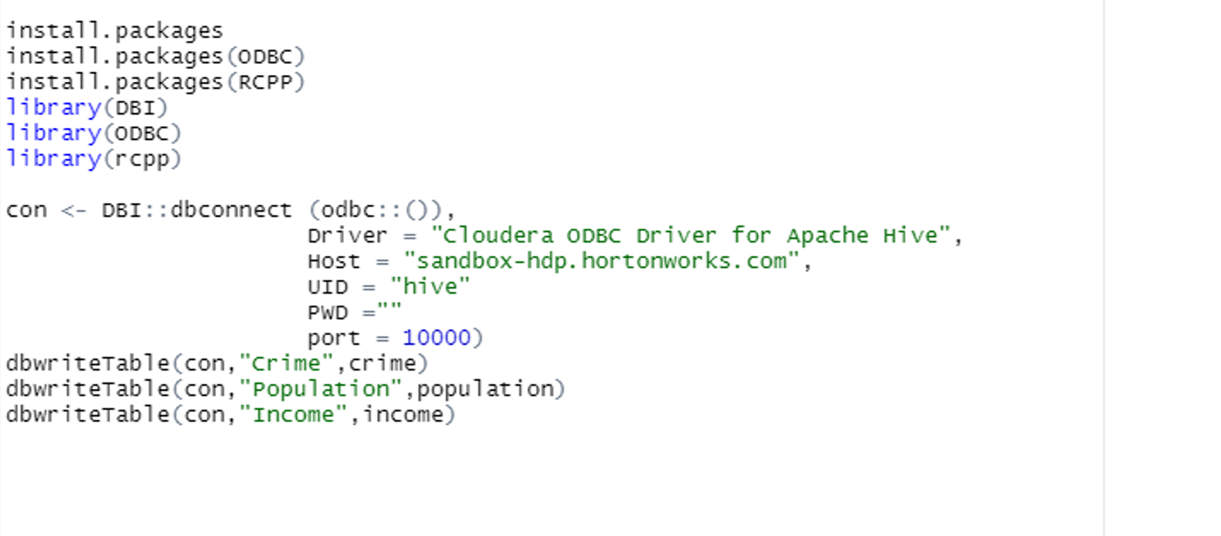
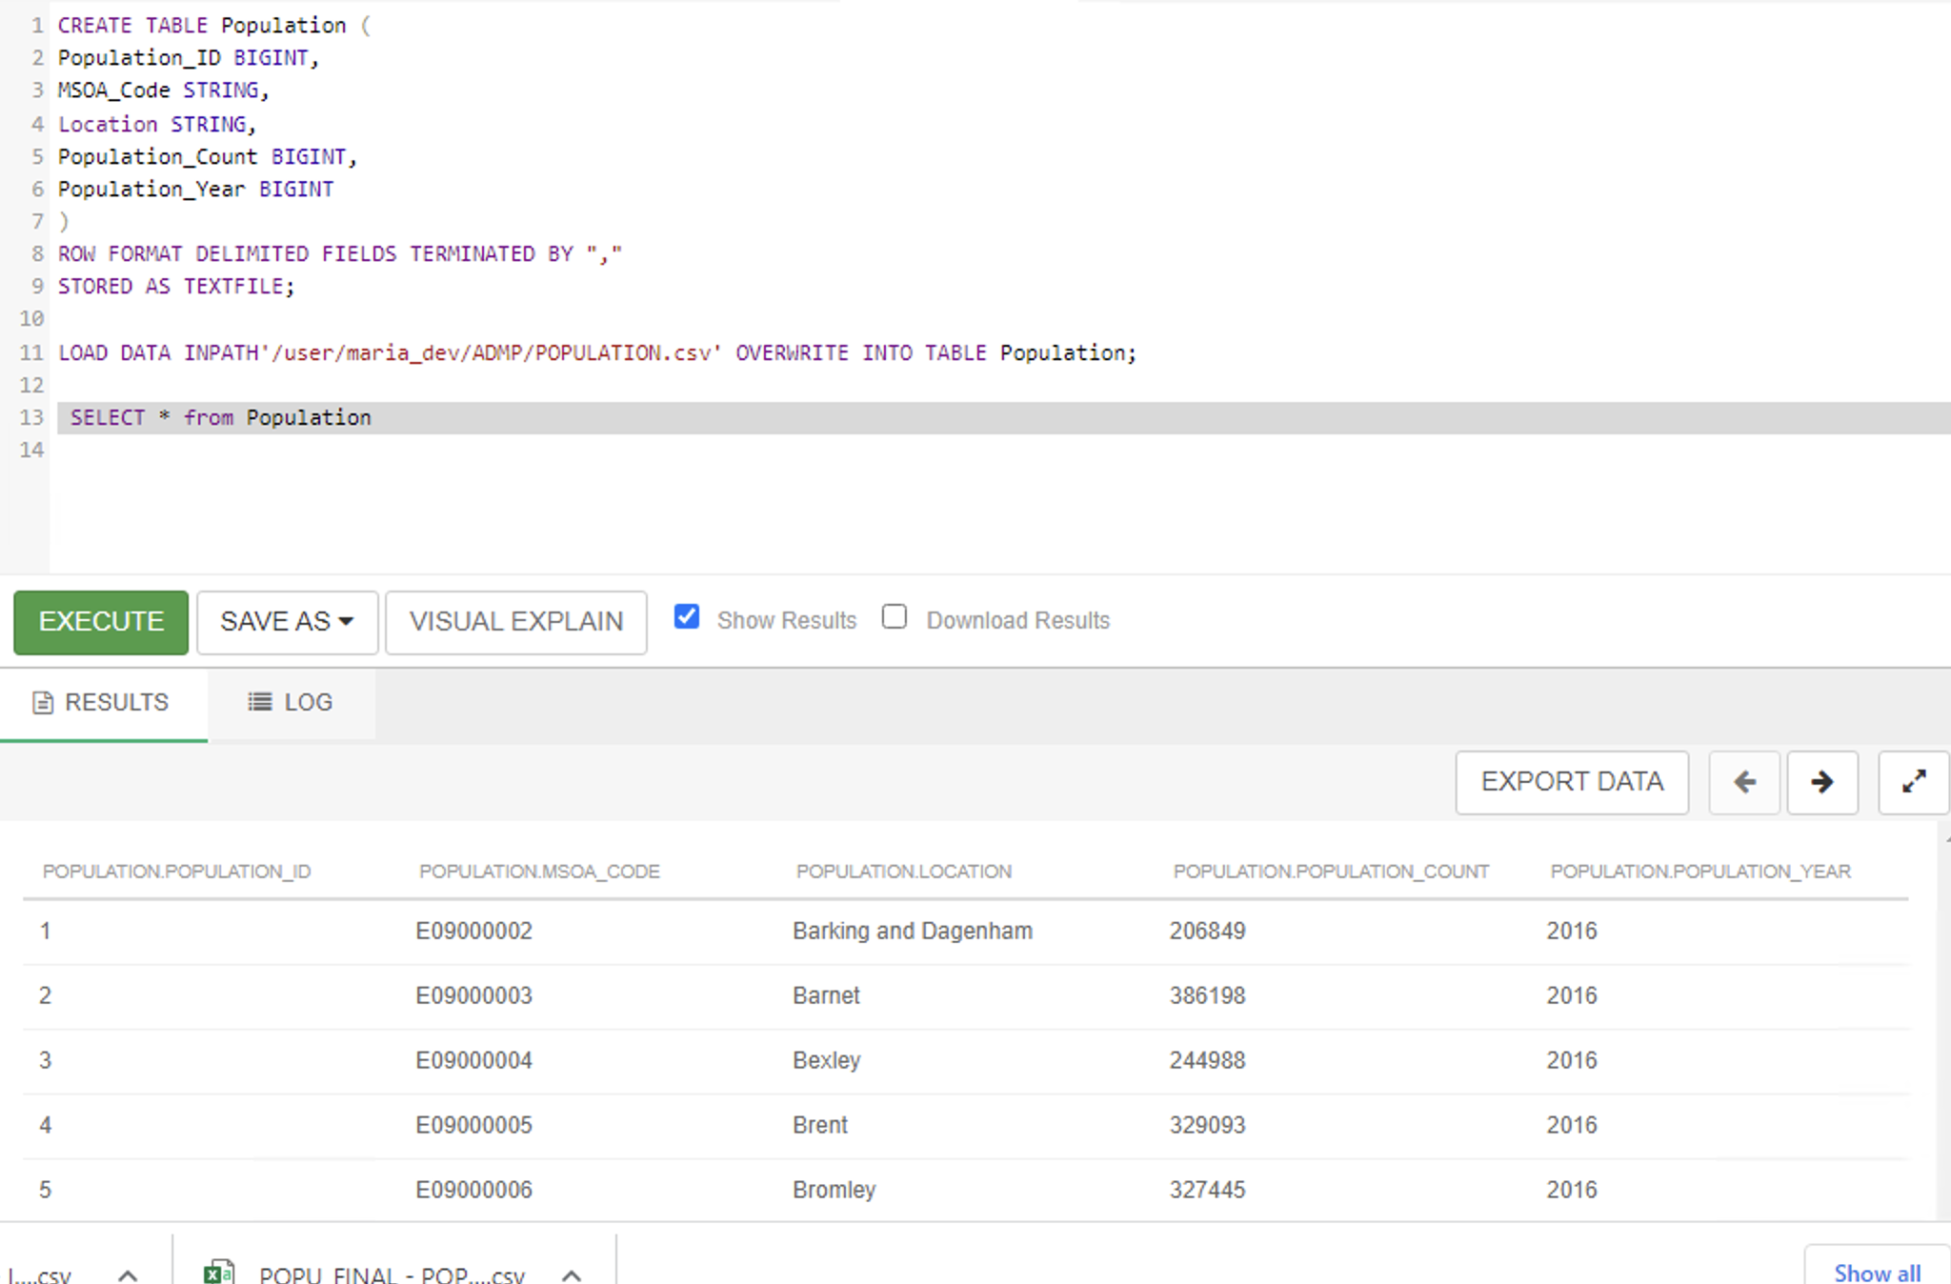
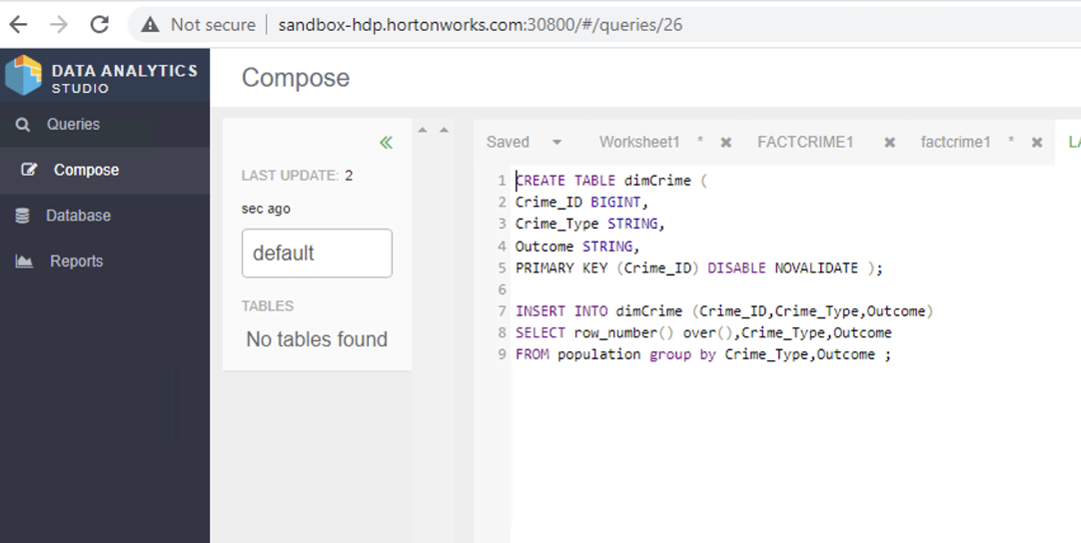
Creation of dimension tables in Hive
fig4.1 R to Hive connection
fig 4.2 Table dimcrime creation
fig 4.3 Table dimpopulation creation

Slide 26
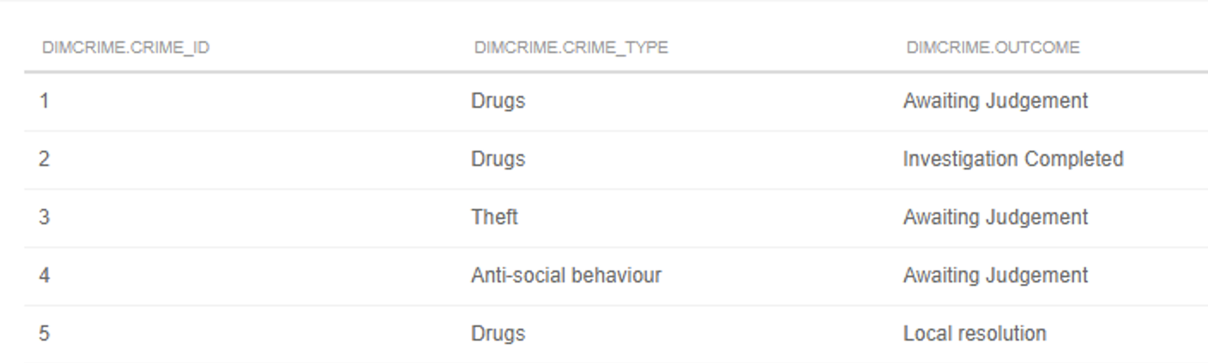
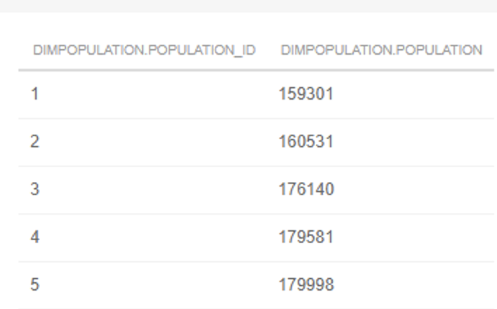
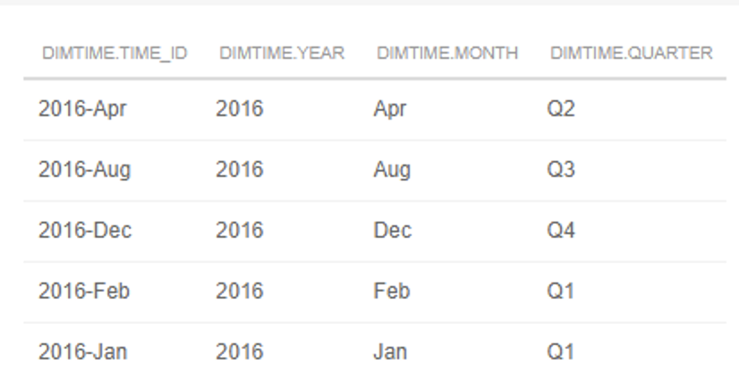
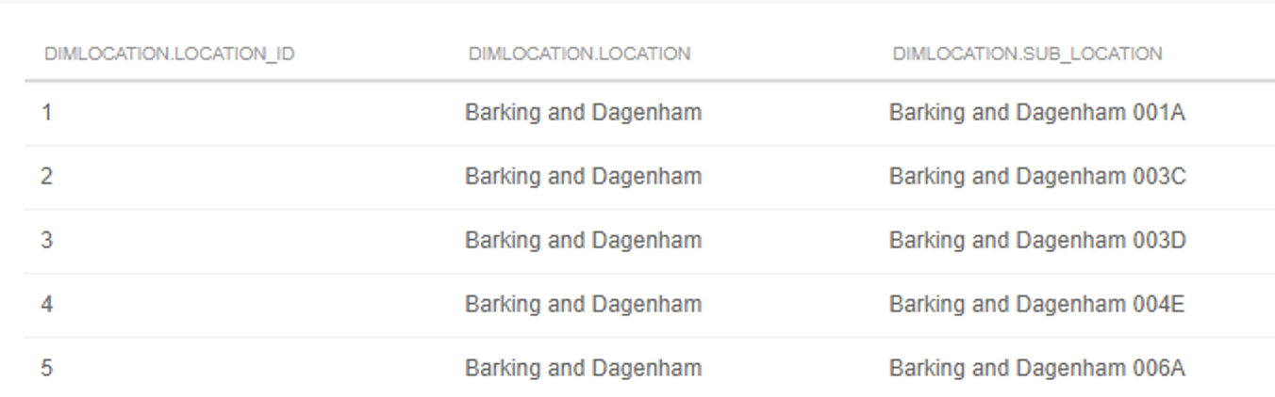
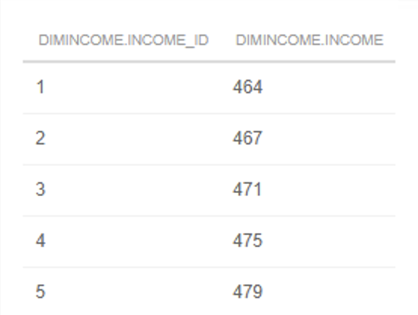
Creation of Dimension tables…cont
fig4.4 dimpopulation
fig4.5 dimtime
fig4.3 dimcrime
fig4.6 dimincome
fig4.7 dimlocation

Slide 27
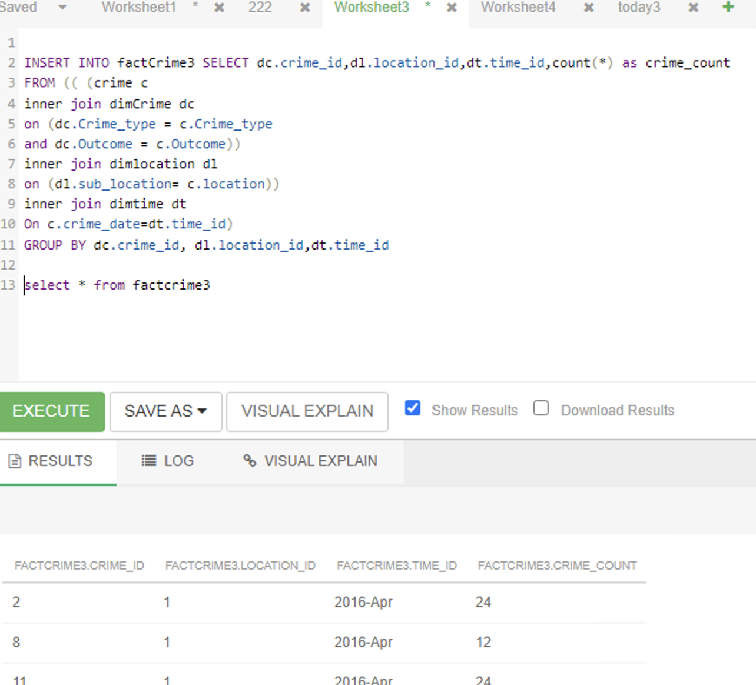
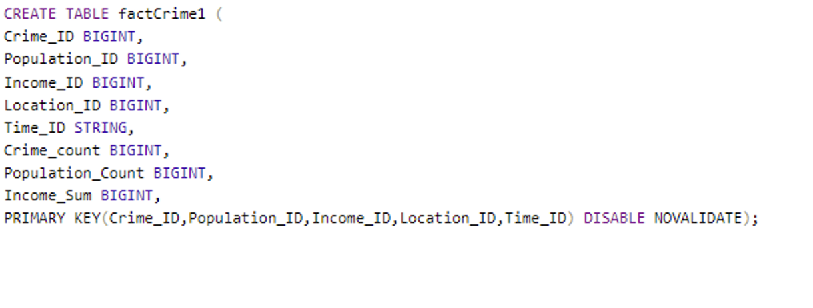
Creation of fact tables in Hive
fig4.8 factcrime1
fig4.9 factcrime3 data insertion code

Slide 28
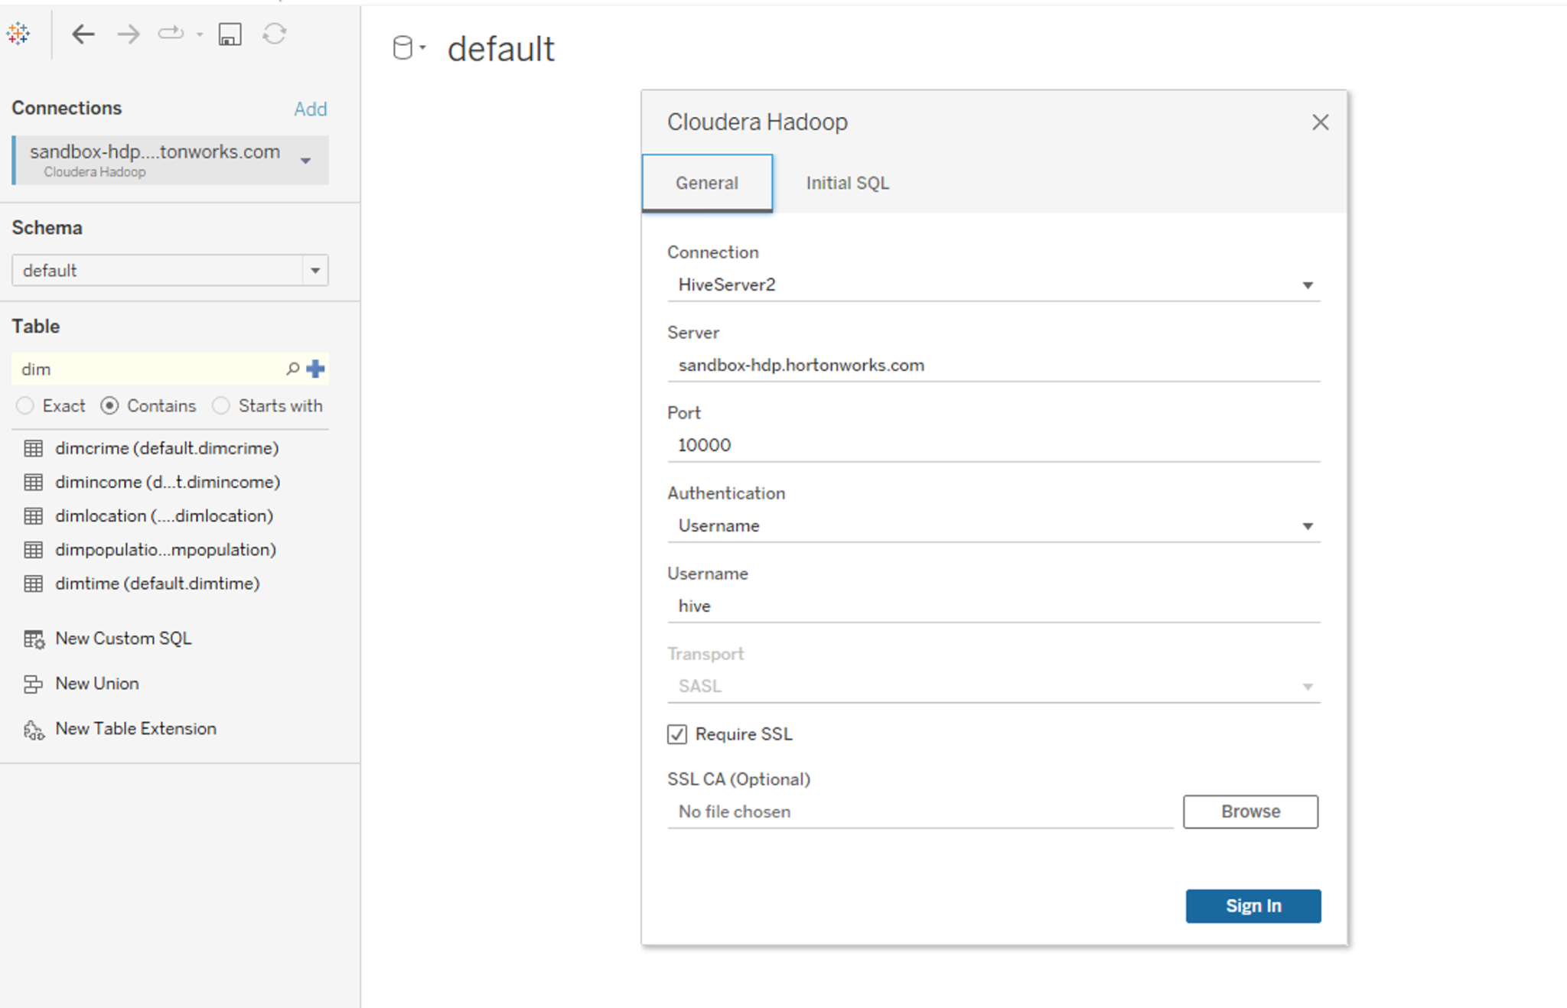
Data Visualization
HIVE TO TABLEAU CONNECTIVITY
fig 5.1 Hive to tableau connectivity

Slide 29
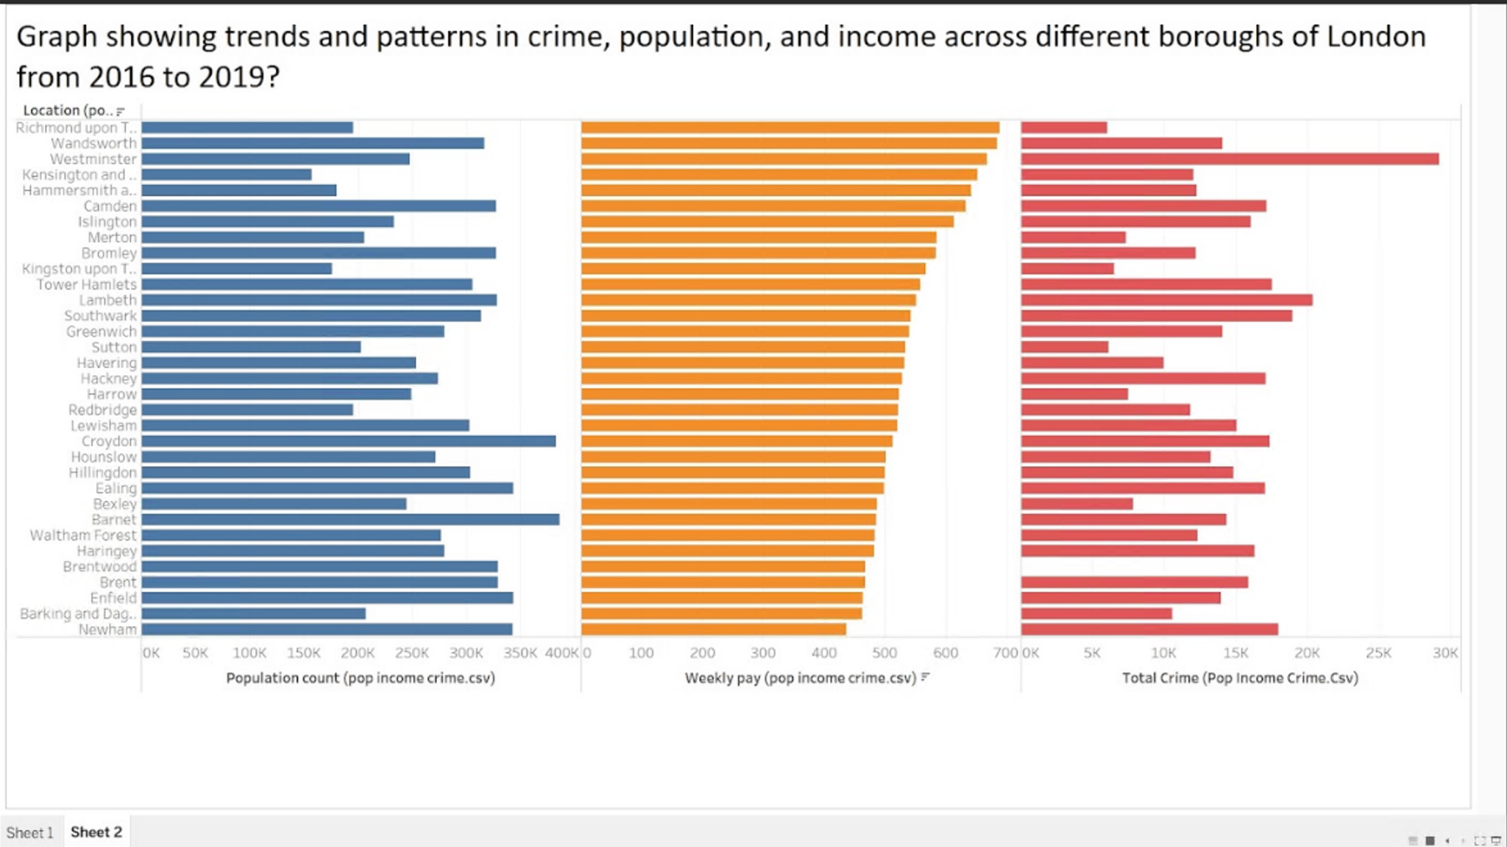
Business Question 1: .What are the trends and patterns in crime, population, and income across different regions of London from 2016 to 2019?
fig 5.2
The above graph shows the trend of crime, population and income in London betweeen 2016 and 2019. There is relatively even pattern of income, population and crime. Westminster shows the borough with the highest crime count with high population and income rates. The average crime count is about 18,000 and most of the borough have a weekly earning of above 400GBP.
Notes:
This graph shows the increase and decrease of crime population and income across diffrent boroughs of London

Slide 30
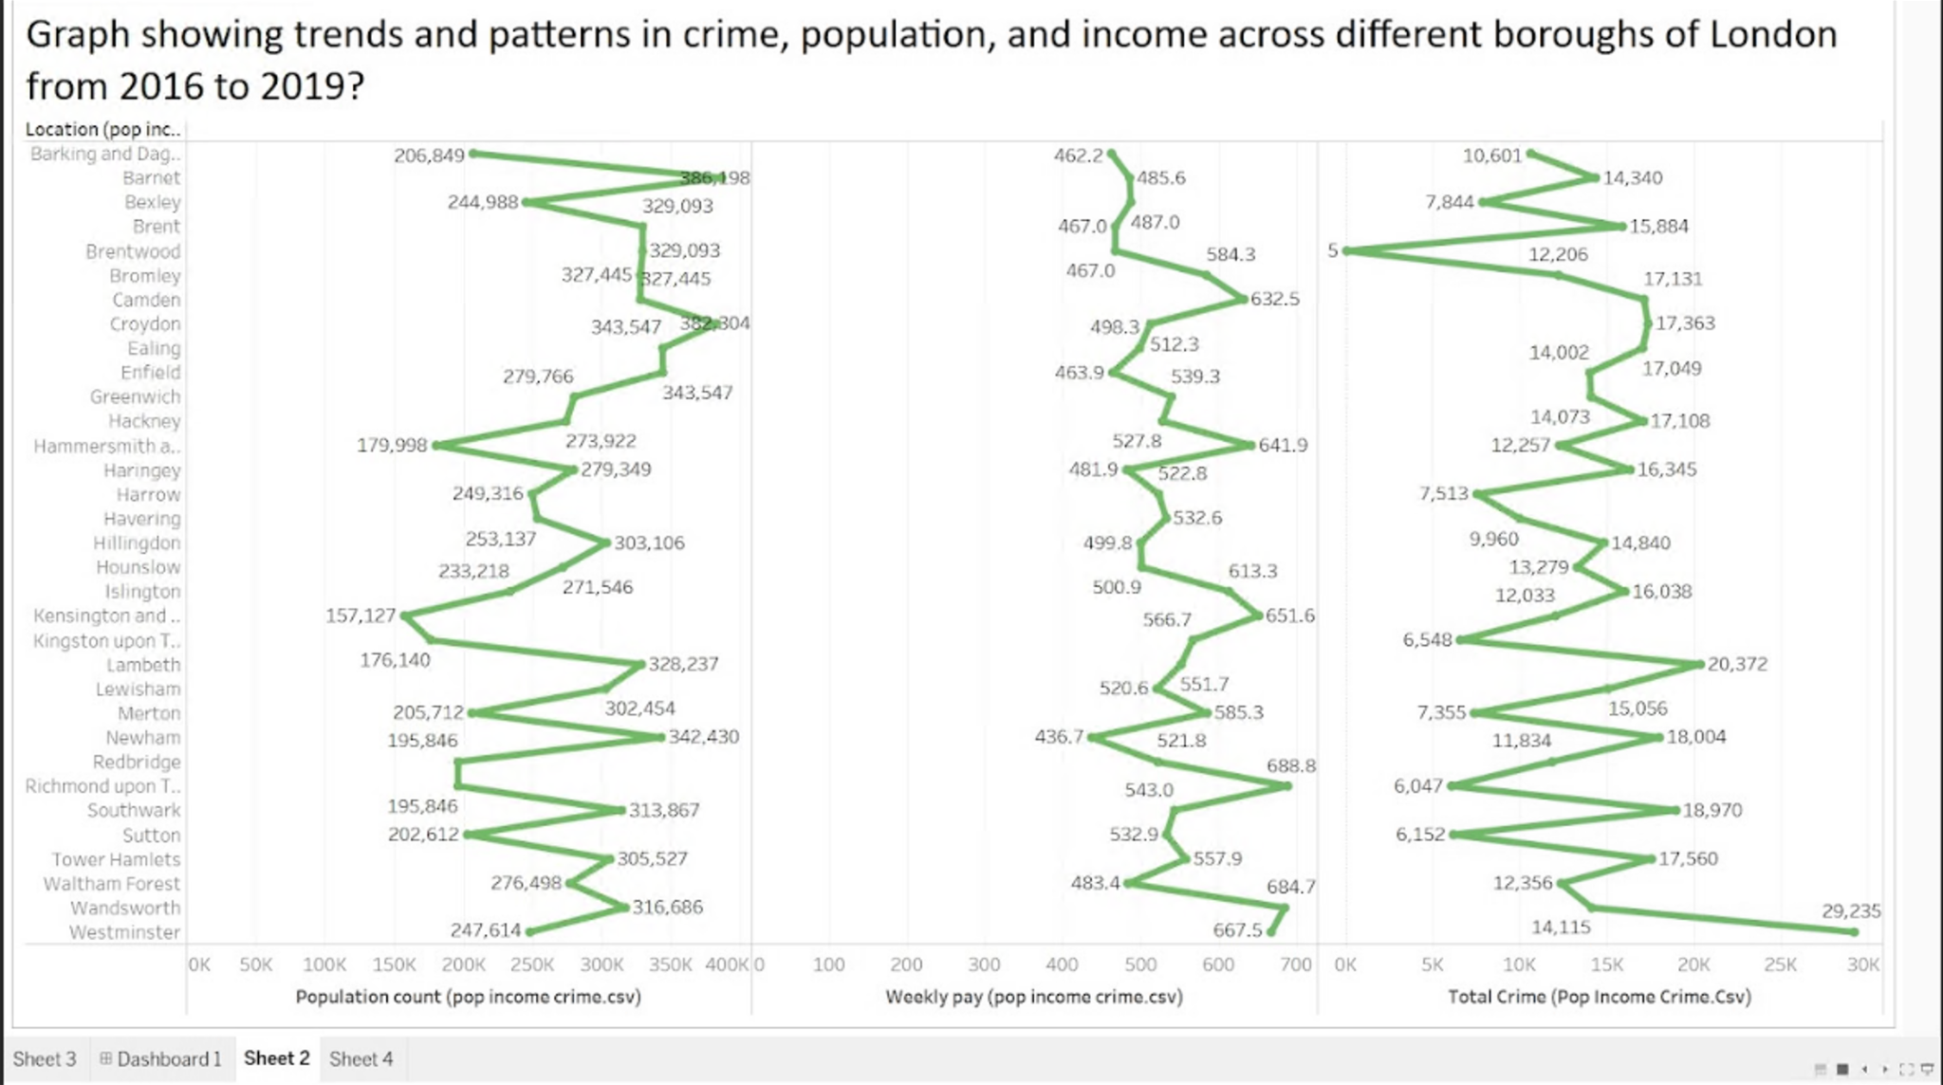
Business Question 1(contd)
fig 5.3
It can be clearly seen that regions with relatively high weekly income of above £600 on the average have have a low crime record with an obvious exception of Westminster which falls within range of high populated area, relatively high weekly income and high crime record within the period in consideration. Brent shows the lowest crime region with an average weekly income of about £462.

Slide 31
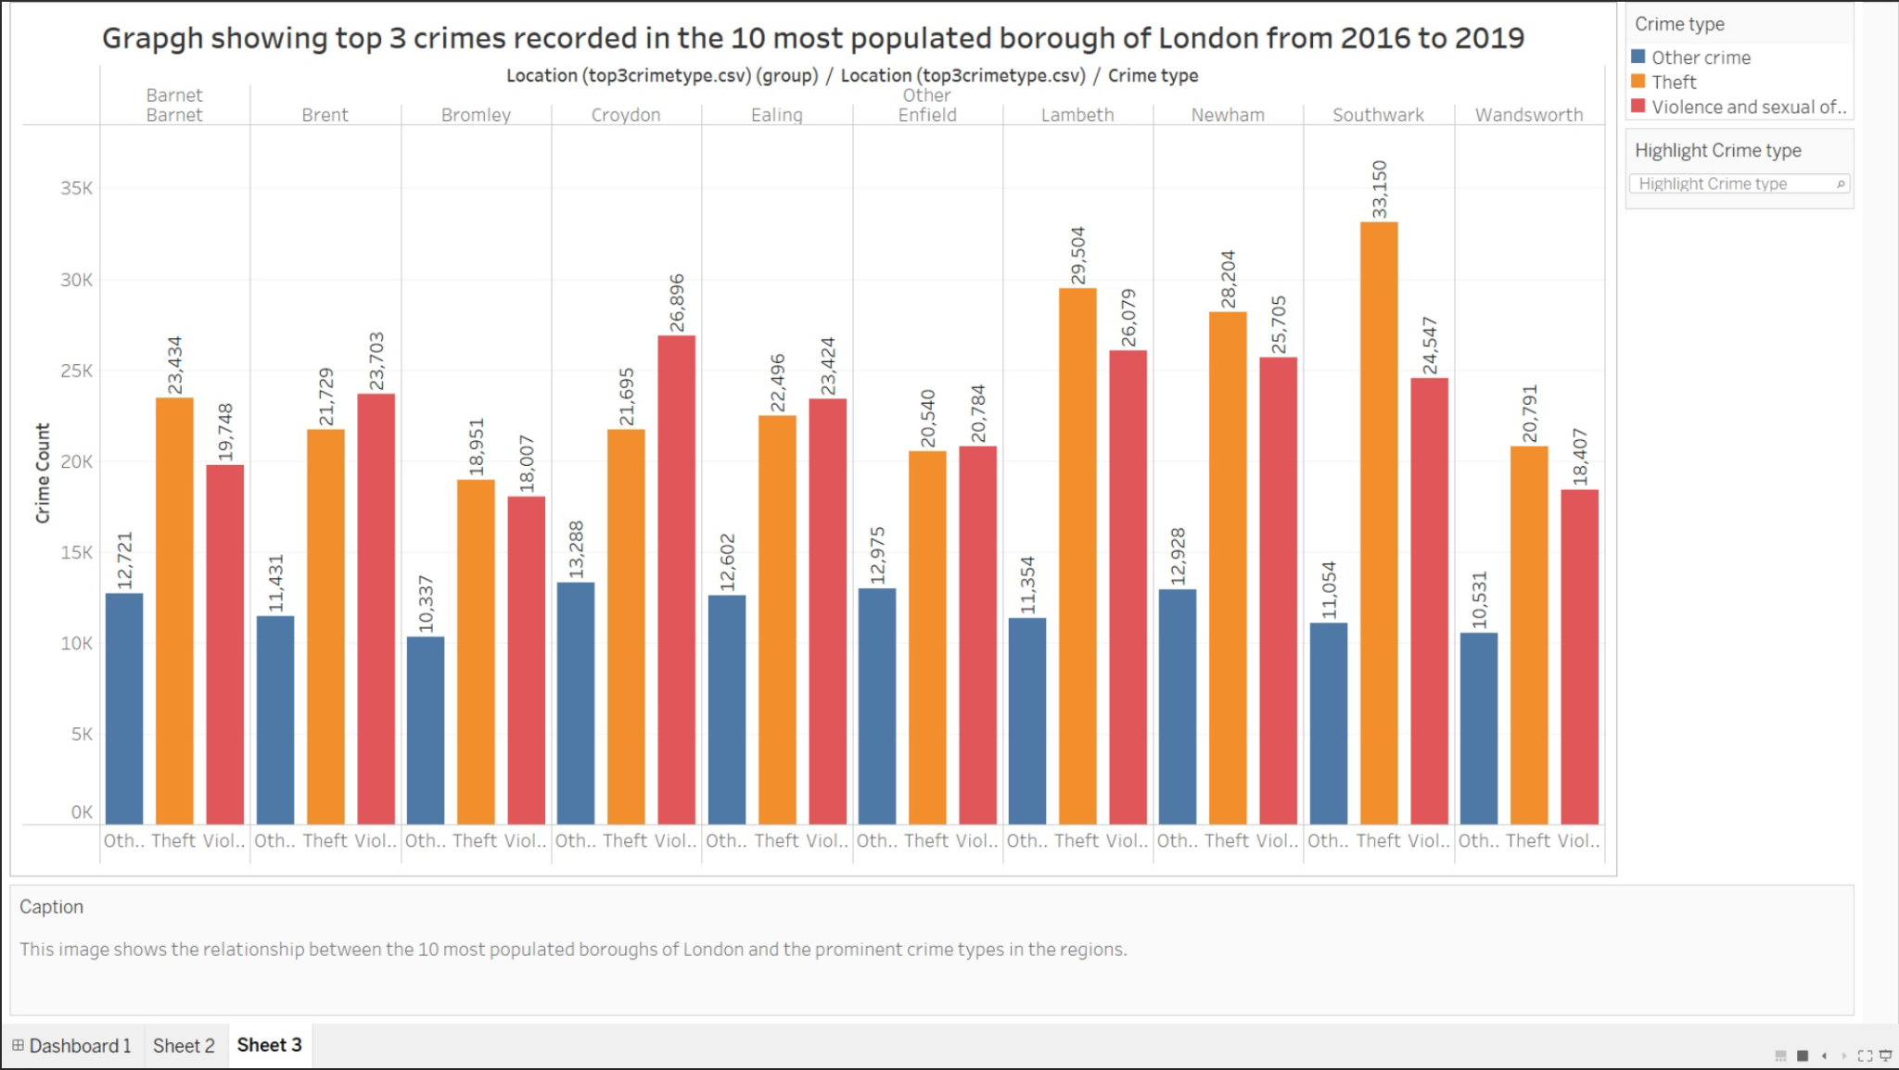
Business Question 2:What are the top three types of crime recorded in the 10 most populated boroughs of London from 2016 to 2019?
fig 6.1
This figure shows the 3 most common crimes recorded in 10 most populated boroughs. Theft is seen as the most common and high count among the 10 boroughs, with violence and sexual offences as second. Both crime types can be categorise as social related crimes. This may be probably justified as the effect of population and its social impact on community safety. High population density resulting in common social related crimes

Slide 32
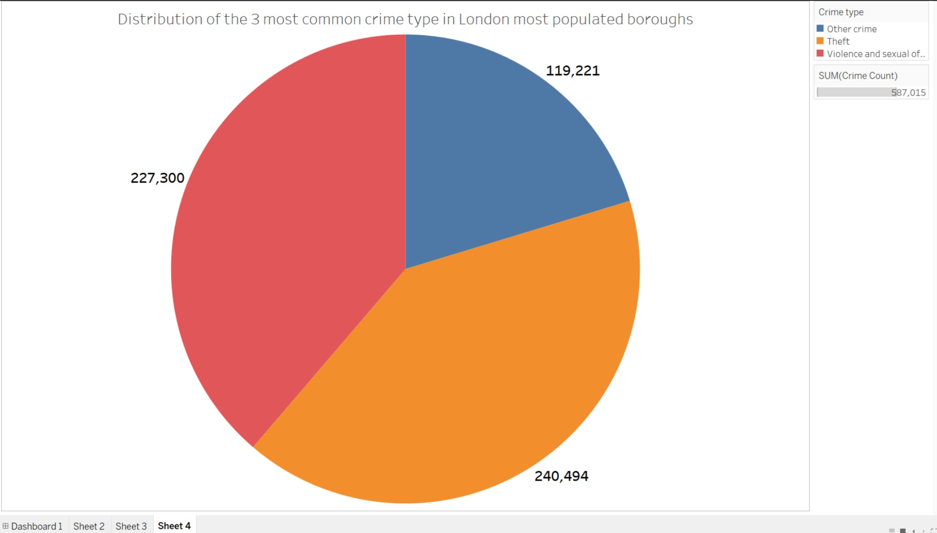
Business Question 2(contd)
fig 6.2
The above pie chart shows the distribution of the 3 most common crime types identifed among the 10 most populated boroughs in London.

Slide 33
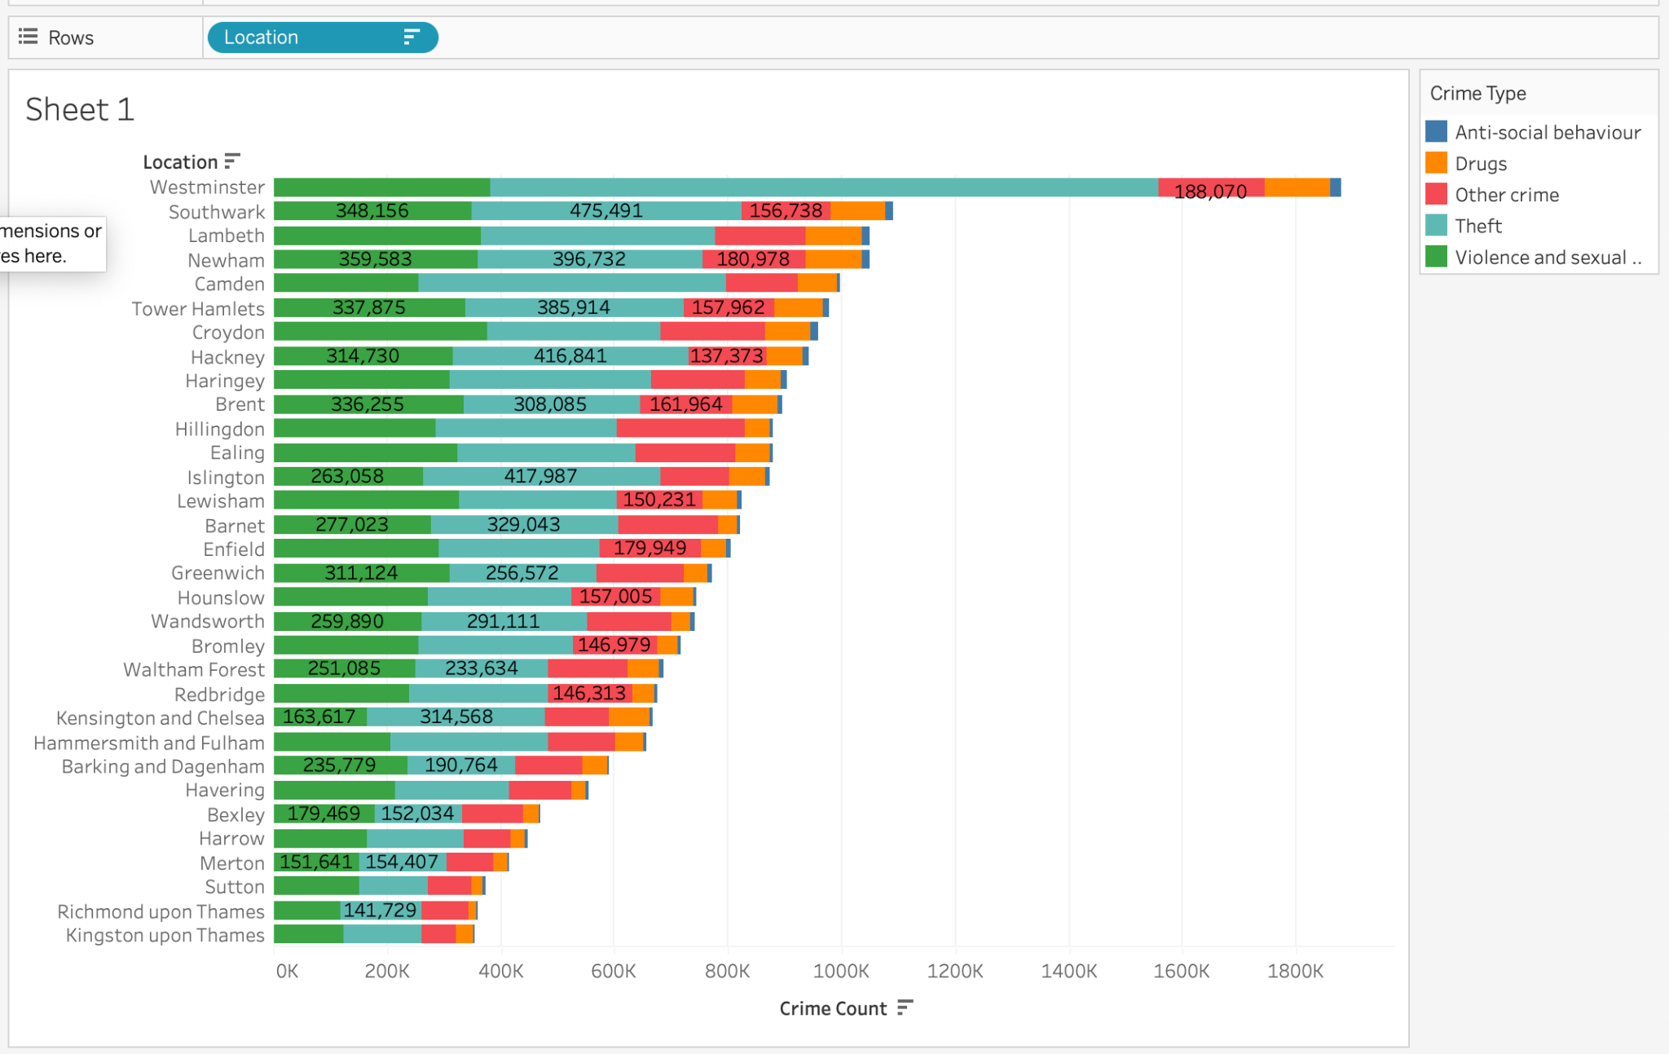
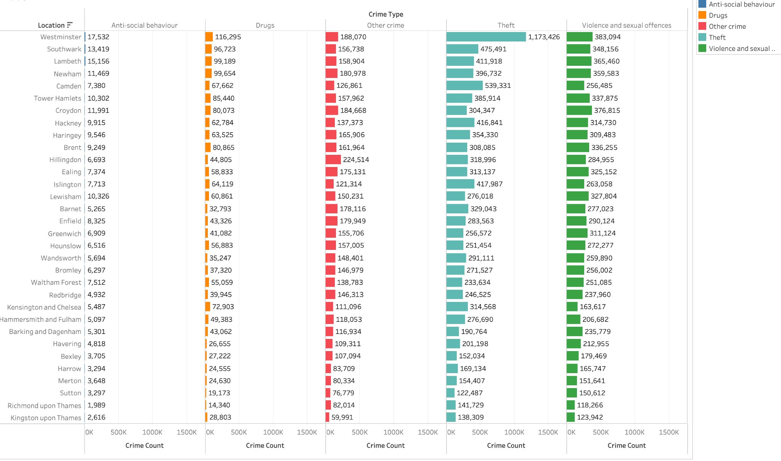
Business Question 3: What is the highest crime count and most occurred type of crime recorded in different boroughs of London quarterly from 2016 to 2019?
Theft can be seen as the most common type of crime across all boroughs of London followed by violence and sexual offences. Westminster still has the highest crime count and Kingston upon thames has has the least crime records.
fig 7.1
fig 7.2

Slide 34
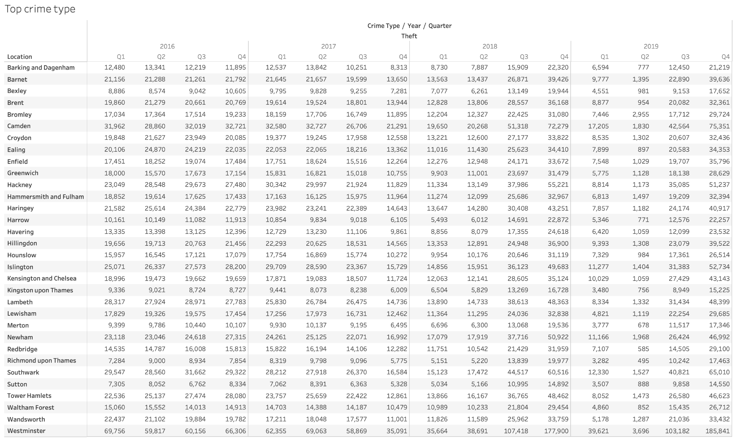
Business Question3:(contd)
fig 7.3
Notes:
The above table shows the quarterly crime count of London borough. There are relatively equal proportion of crime count across the quarter of the year. However, Q4 seems to have a slightly larger count of crimes across all borough probably because its close to the end of the year.

Slide 35
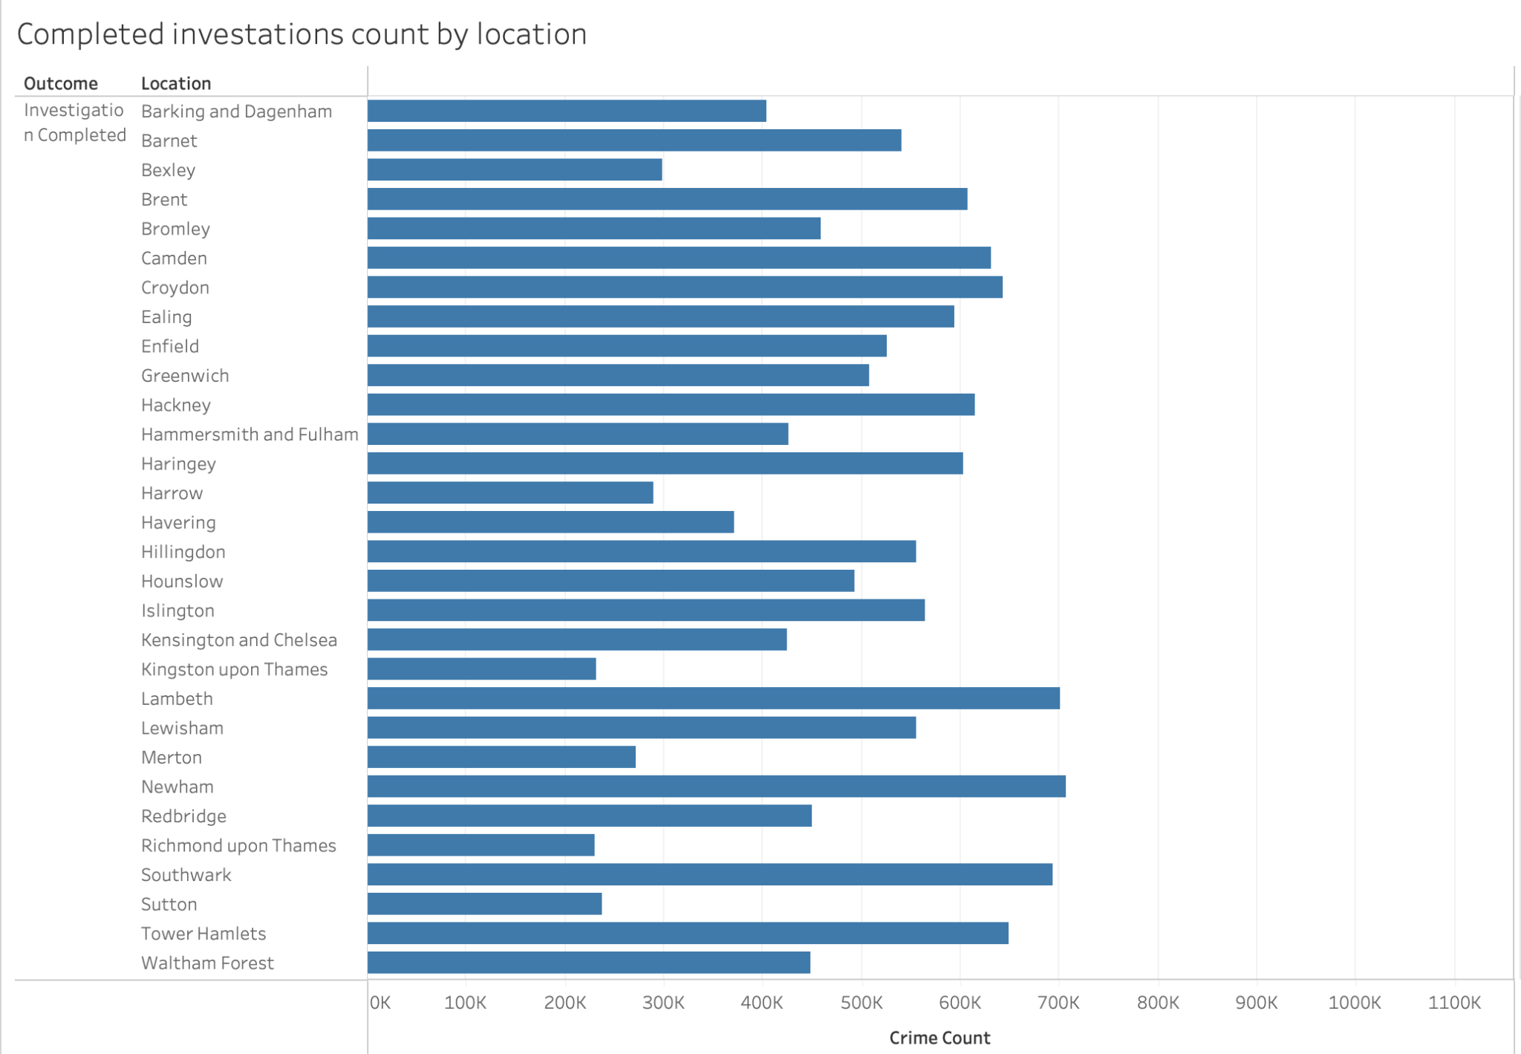
Business Question 4: How many reported crime cases by type were completed monthly by investigation in all regions of London from 2016 to 2019?
fig 8.1
The graph above shows the aggregate by month of the completed investigations carried out on the crime records. majority of the crime offences investigations was completed within the time frame under study.

Slide 36
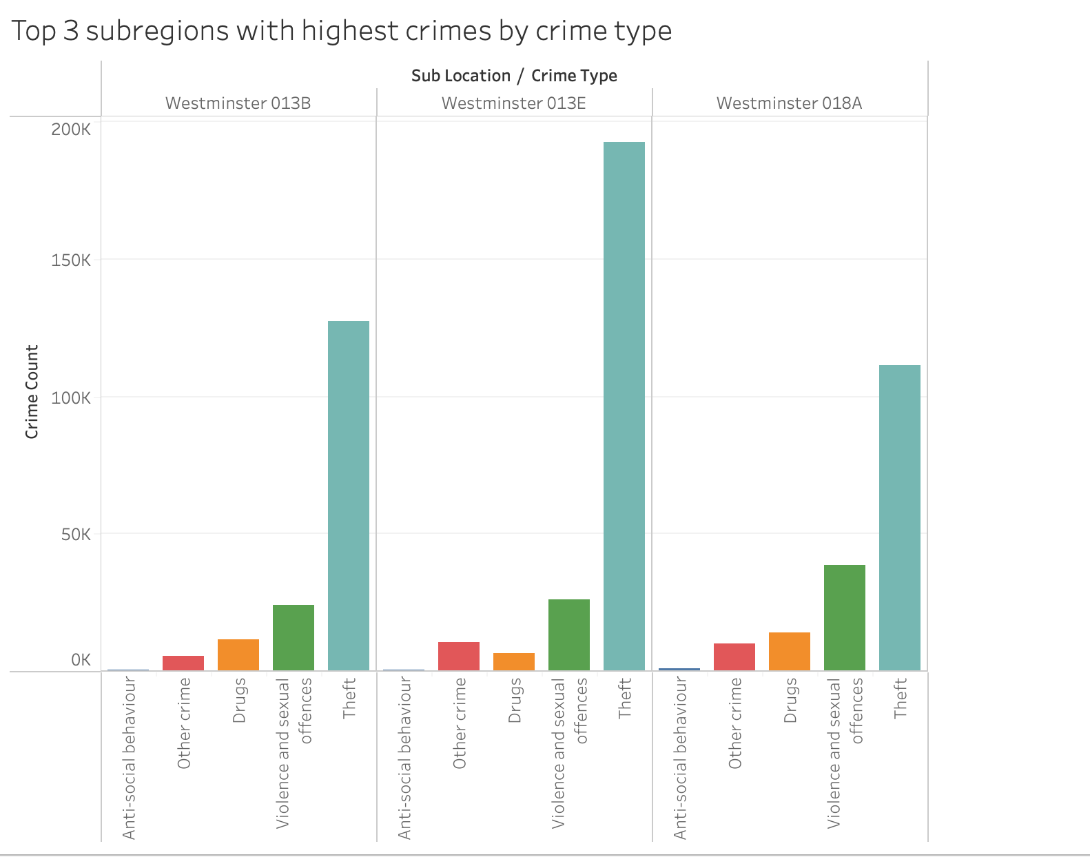
Business Question 5: What top 3 subregions with highest crime rate in Boroughs of London in 2019 are most in need of increased security measures.
fig 8.2
Westminster has the highest crime records in all the boroughs in London and the above grapgh presents the subregions that contributed to being the highest crime recorded borough. Westminster 013E has the record with theft being the prominent crime type.

Slide 37
Conclusion
Based on the above analysis, it can be deduced that crime rate in London is influenced by socio-economic status and population density. Prominent crime type being theft and violence and sexual offences are both socially driven which make population and earning power a factor for crime prevalence. A detailed analysis of crime patterns and trends requires careful consideration of these factors. While, there are considerable number of completed investigations on crime offences, policy maker should focus more on prevention of crime occurrence.

Slide 38
Recommendation
Proper crime responses should be implemented to prevent crime occurrence. Infrastructure to monitoring and prediction of crime prone areas should be emplored to help in prevention of crimes.
Conduct a risk assessment to determine the most effective security measures the areas. This can include increasing police patrols, installing surveillance cameras, improving lighting and environmental design, and engaging with community groups.
Create a thorough security strategy that considers the unique requirements and features of each subregion. This strategy should be supported by data and involve cooperation between law enforcement, regional administration, and neighbourhood organisations.
Continuously update data: Continuously update the data and analysis to ensure that the crime analysis remains current and relevant.

Slide 39
References
Clarke, R., & Eck, J. E. (2014). Become a problem-solving crime analyst. Routledge.
Kattankulathur, K. (2018). Crime analysis and prediction using Big Data. International Journal of Pure and Applied Mathematics, 119(12), 207-211.
Ratcliffe, J. H., & McCullagh, M. J. (1998). Aoristic crime analysis. International Journal of Geographical Information Science, 12(7), 751-764.
Sathyadevan, S., Devan, M. S., & Gangadharan, S. S. (2014). Crime analysis and prediction using data mining. Paper presented at the 2014 First International Conference on Networks & Soft Computing (ICNSC2014), 406-412.
Shaw, S., Vermeulen, A., Gupta, A., & Kjerrumgaard, D. (2016). Practical Hive A Guide to Hadoop’s Data Warehouse
Bachner, J. (2013). Predictive policing: preventing crime with data and analytics. IBM Center for the Business of Government Washington, DC

